Slide 1

Inspiring innovations
by;:- v sri data bharadwaj (b-tech 2nd ai)
shanmukha mohnish (b-tech 2nd cse)
anirudh bulusu (b-tech 2nd cse)

Slide 2

PROBLEM STATEMENT
PROBLEM STATEMENT
We can make a platform which connects organizational stake holders to help students to find their suitable job for there profile.

Slide 3
DESCRIPTION
Talent and education comes from hard-work and knowledge. So, there by we can say that every student who has talent irrespective of their background with no fear are eligible to be placed/get settled in different domain of companies/jobs of their interests. We are creating a platform where each and every student can show their talent and get settled.
This application is not only applicable for student analysis but also for the college prosperities, Indian integrity and also company development . This application’s analysis will prove to be vital in predicting the average number of talent’s at present and as well in the future.
By this application , the revolution of different domains come into practice quickly from developers to students .
For example:- By the time AI was introduced to students, the world has started already developing it. So, in our application we introduce all kinds of new domains.

Slide 4
functionality
F1
F5
STUDENT PROFILE
DOMAIN TEST
Where student can create/edit their profile.
Student can check their ability and talent in specific domain where he/she is interested.
F2
INTRESTED JOBS/INTERNSHIPS
F6
JOB TRAILS
Students are eligible for job trails from pre final year onwards but there is no restriction on internships.
Any domain student can be a part of basic application.
F3
DOP(DIRECTOR OF PLACEMENT)
F7
WORK EXPERENCE
The person who represents the specific university or college.
Every student must have a intern which provides him/her a experience to do work.
F4
F8
TERMS AND CONDITIONS
Company Executive
Starting from MNCs to STARTUPs register in this platform to choose the best students.
Every details provided by the student must be verified by the respective college coordinator.

Slide 5
Flow chart
Q1
Q2
Q3
Q4
Q5
Q6
Q7
Q8
Creating an account .
Domain selection
Get Certified
Aptitude testing
Ability Testing
Recruitment letter
Agreement letter
Exit
Companies should register themselves.
College/universities coordinator should enroll behalf of college.
Student should create an account and mention proper information.
Students can choose their interested domain.
He should write exam based on his selection of domain.
The exam will be conducted in our platform.
we conduct different domain examinations.
Students should go through aptitude test once they get certified with domain testing
Based on the rank/his performance he/she can get a suitable job/ internship.
The offer letter provided by the companies.
Which the offer letter will be shared to student as well as college/university.
Once the student get offer letter, he must give an agreement letter which tells that he agrees to that job/internship.
If he/she get intern opportunities, he/she is eligible for job trails.
Once any student get job he/she will be removed from this application by verifying with company and college/university.

Slide 6
TECHINICAL REQUIREMENTS
Languages used:
HTML.
CSS.
JavaScript.
MYSQL.
logistic regression(ML) helps student whether he is eligible for a specific company or not.
Linear regression(ML) helps student to analyse his performance in domain tests.
In Django we use the concepts of basic html , CSS and java script for the front end which is to create a web page.
For the backend we use amazon cloud for management of database.

Slide 7
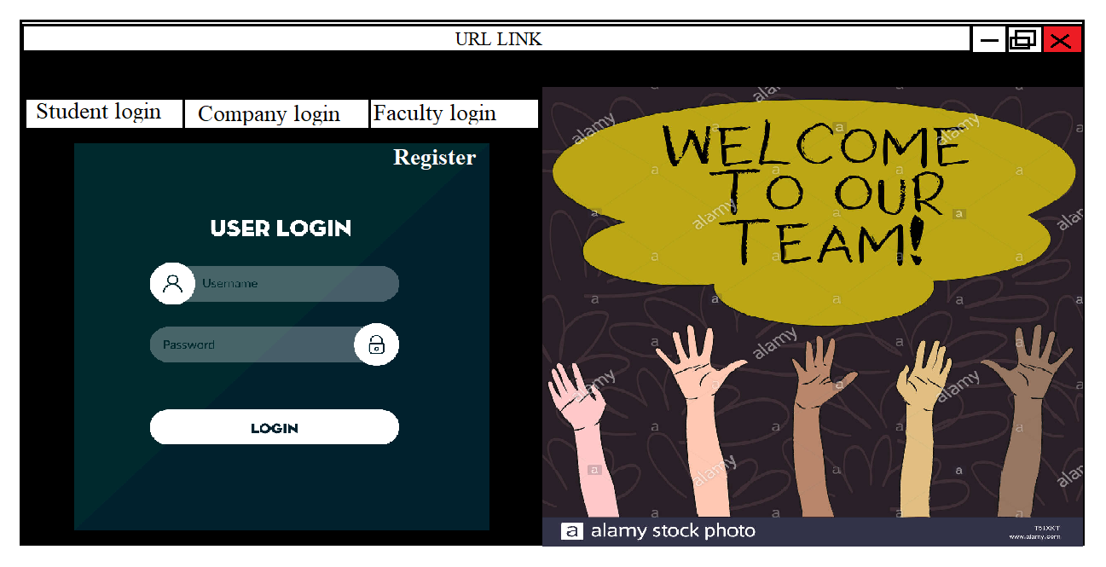

Slide 8
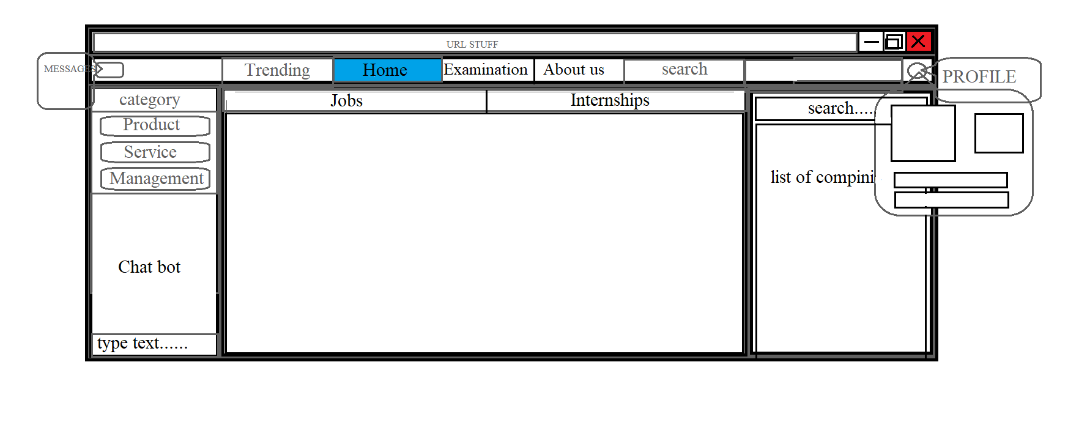
details
photo
settings

Slide 9
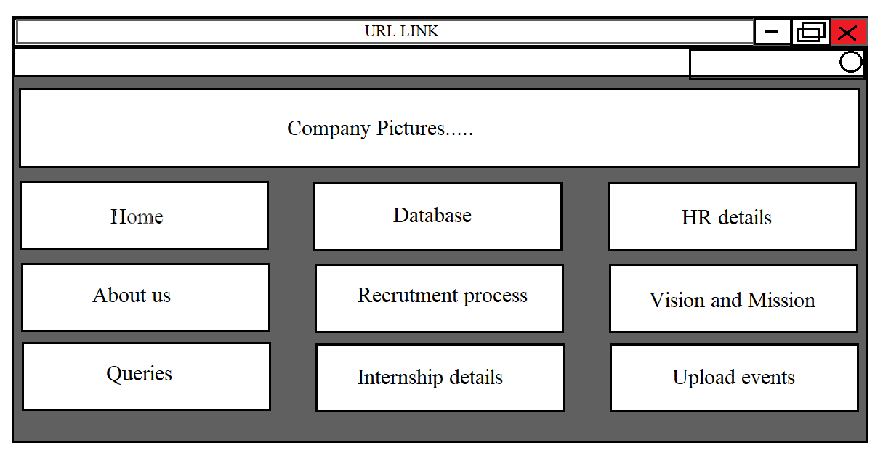
Company interface
User Details

Slide 10
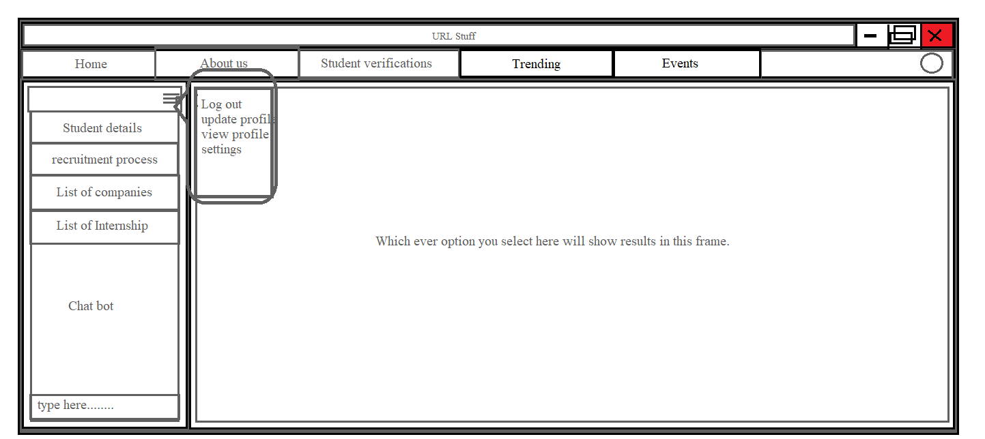
College/university interface
profile

Slide 11

WHAT MAKES MY APPLICATION Different FROM OTHERS?
Students can know about new technologies and can develop themselves.
Not only students but Government and Universities/colleges can get estimated values of student’s performance.
We provide the exact analysis of strengths and weaknesses of students in there interested domain.
We also provide proper upcoming opportunities given by different companies to students.

